Slide 1
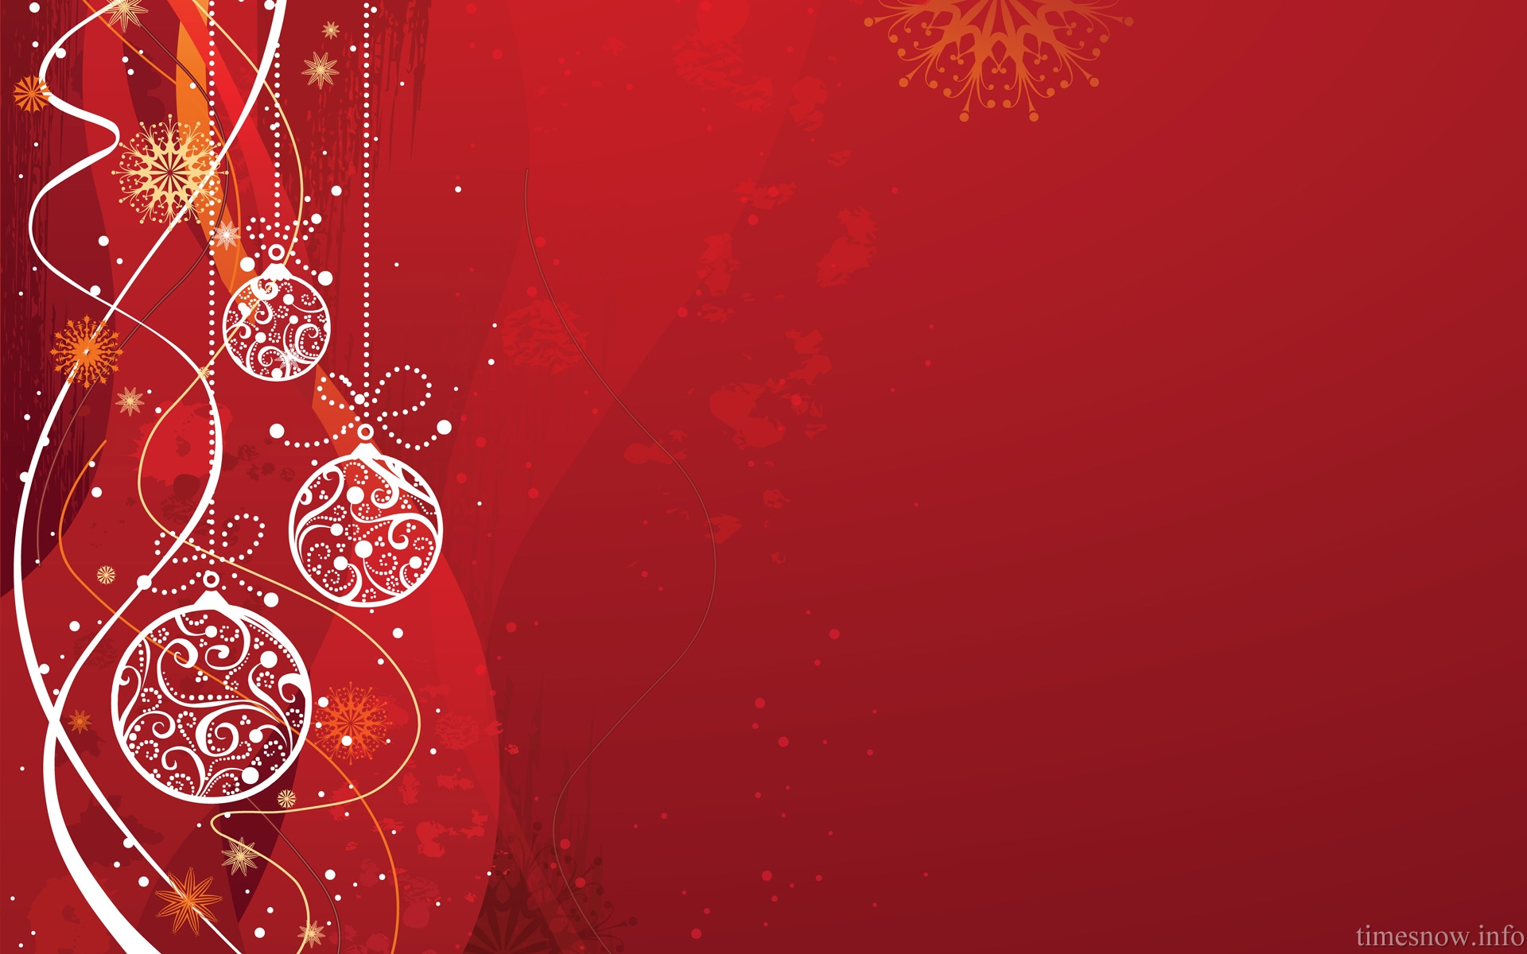
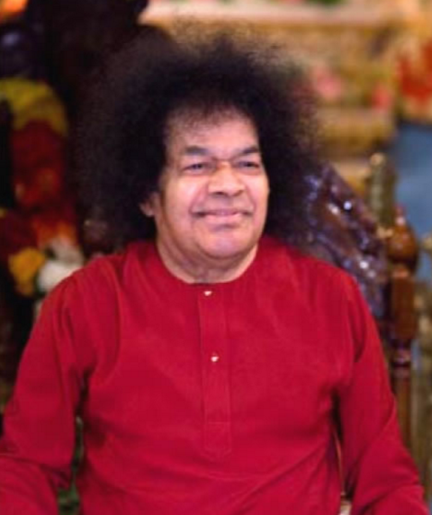
Christmas Carols
Jingle Bells

Slide 2
The Story of Christmas and the Birth of Christ
Many of us are familiar with the basic story of The Nativity, or the divine birth of Jesus to the Virgin Mary, as was foretold by prophecy by the Angel Gabriel. According to Biblical sources and popular tradition, the baby Jesus was born to Mary and Joseph in Bethlehem, where they were traveling from their home in Nazareth (which was about 90 miles away). Unable to find any room at an inn, Mary gives birth to Jesus in a manger. Soon after, an angel comes to shepherds in nearby fields to bring them “Great news of joy! To you is born this day in the city of David, a Savior who is the Messiah, the Lord!” This news is spread by a choir of angels, and soon these shepherds travel by night to Bethlehem to find the Baby Jesus, along with Mary and Joseph, in the manger.
Jingle Bells

Slide 3
Jingle Bells
Silent Night

Slide 4
Silent night, Holy night
All is calm, All is bright
Round yon Virgin
Mother and Child
Holy Infant so tender and mild
Sleep in heavenly peace
Sleep in heavenly peace
Jingle Bells

Slide 5
Silent night, Holy night Shepherds quake at the sight Glories stream from Heaven afar Heavenly host sings Alleluia Christ, the Saviour, is born! Christ, the Saviour, is born!
Jingle Bells

Slide 6
Silent night, Holy night
All is calm, All is bright
Round yon Virgin
Mother and Child
Holy Infant So tender and mild
Sleep in heavenly peace
Sleep in heavenly peace
Sleep in heavenly peace (Slow…)
Jingle Bells

Slide 7
There is also the story of the “three wise men” or three kings from the East, who visit the Baby Jesus. According to some sources, these three wise men were guided by a star from the East to Jerusalem, and then to Bethlehem where they found Jesus laying in the manger. There, they kneel before Christ and each gave Him a gift: gold, frankincense, and myrrh. The wise men return to their own land without revealing the location of the manger to King Herod, who is jealous and fearful of what Jesus represents (because of a prophecy calling Him the “King of the Jews,” which he understands to mean the “Messiah” or Savior).
Jingle Bells

Slide 8
Joy to the World
Jingle Bells

Slide 9
Joy to the world!
The Lord is come. Let earth receive her King Let every heart prepare Him room And heaven and nature sing
And heaven and nature sing And heaven and heaven and nature sing
Jingle Bells

Slide 10
Joy to the world
The Savior reigns Let men their songs employ While fields and floods,
Rocks, hills and plains Repeat the sounding joy,
Repeat the sounding joy Repeat, repeat, the sounding joy
Jingle Bells

Slide 11
No more let sins
And sorrows grow
Nor thorns infest the ground
He comes to make
His blessings flow
Far as the curse is found
Far as the curse is found
Far as, far as, the curse is found
Jingle Bells

Slide 12
He rules the world
With truth and grace
And makes the nations prove
The glories of His righteousness
And wonders of His love
And wonders of His love
And wonders, wonders of His love
Jingle Bells

Slide 13
Hark the Herald Angels Sing
Jingle Bells

Slide 14
Hark the herald angels sing Glory to the newborn King! Peace on earth and mercy mild God and sinners reconciled Joyful, all ye nations rise Join the triumph of the skies With the angelic host proclaim: Christ is born in Bethlehem Hark! The herald angels sing Glory to the newborn King!
Jingle Bells

Slide 15
Hail the heaven-born Prince of Peace! Hail the Son of Righteousness! Light and life to all He brings Risen with healing in His wings Mild He lays His glory by Born that man no more may die Born to raise the sons of earth Born to give them second birth Hark! The herald angels sing Glory to the newborn King!
Jingle Bells

Slide 16
Jingle Bells
Deck the Halls

Slide 17
Deck the halls with boughs of holly, Fa la la la la, la la la la. Tis the season to be jolly, Fa la la la la, la la la la. Don we now our gay apparel, Fa la la, la la la, la la la. Troll the ancient Yule tide carol, Fa la la la la, la la la la.
Jingle Bells

Slide 18
See the blazing Yule before us, Fa la la la la, la la la la. Strike the harp and join the chorus. Fa la la la la, la la la la. Follow me in merry measure, Fa la la, la la la, la la la. While I tell of Yuletide treasure, Fa la la la la, la la la la.
Jingle Bells

Slide 19
Fast away the old year passes, Fa la la la la, la la la la. Hail the new, ye lads and lasses, Fa la la la la, la la la la. Sing we joyous, all together, Fa la la, la la la, la la la. Heedless of the wind and weather, Fa la la la la, la la la la (3 Times).
Jingle Bells

Slide 20
What does Swami say about the Significance of Christmas and How to Celebrate the Birth of Jesus Christ?
Divine Discourse: December 25, 1994
Today, we celebrate Christ's birthday. It is said that when Jesus was born in a manger, three kings were led by a star to Jesus’ place of birth. In fact, they were not kings but three shepherds. One of them, seeing the infant Jesus, observed, "This child will be a lover of God." A second one said, "No. God will love him." The third one said, "Verily He is God Himself."
Jingle Bells

Slide 21
The true significance of these three statements is,
To love God is to be His Messenger. To be loved by God is to be a son of God. The final state is to be one with God.
As Jesus said, "I and my Father are one." Thus. all persons are messengers of God. This means that they should divinize themselves. When can men call themselves sons of God? … Men can describe themselves as "sons of God" only when they are completely free from selfishness and become Godly. To call yourself the "son of God," you have to manifest the qualities of the Father.
Jingle Bells

Slide 22
O Come All
Ye Faithful
Jingle Bells

Slide 23
O come, all ye faithful, Joyful and triumphant, O come ye, O come ye, to Bethlehem. Come and behold Him, Born the King of angels.
Jingle Bells

Slide 24
[Refrain]
O come, let us adore Him, O come, let us adore Him, O come, let us adore Him, Christ the Lord.
Jingle Bells

Slide 25
Sing, choirs of angels, Sing in exultation; O sing, all ye citizens of heaven above! Glory to God, Glory in the highest;
Jingle Bells

Slide 26
[Refrain]
O come, let us adore Him, O come, let us adore Him,
[slowly]
O come, let us adore Him, Christ the Lord.
Jingle Bells

Slide 27
Jingle Bells
Jingle Bells

Slide 28
Dashing through the snow
In a one horse open sleigh O'er the fields we go
Laughing all the way (Ha Ha Ha!!!) Bells on bobtails ring
Making spirits bright What fun it is to ride and sing
A sleighing song tonight
Jingle Bells

Slide 29
Jingle bells, jingle bells
Jingle all the way Oh, what fun it is to ride
In a one horse open sleigh, Hey! Jingle bells, jingle bells
Jingle all the way Oh, what fun it is to ride
In a one horse open sleigh
Jingle Bells

Slide 30
Dashing through the snow
In a one horse open sleigh O'er the fields we go
Laughing all the way (Ha Ha Ha!!!) Bells on bobtails ring
Making spirits bright What fun it is to ride and sing
A sleighing song tonight
Jingle Bells

Slide 31
Jingle bells Jingle bells
Jingle all the way Oh, what fun it is to ride
In a one horse open sleigh, Hey! Jingle bells, jingle bells
Jingle all the way Oh, what fun it is to ride
(slow….harmony)
In a one horse open sleigh.
Jingle Bells

Slide 32
Feliz Navidad
Jingle Bells

Slide 33
Feliz Navidad (3)
Prospero Año y Felicidad
Feliz Navidad (3)
Prospero Año y Felicidad
I wanna wish you a Merry Christmas
I wanna wish you a Merry Christmas
I wanna wish you a Merry Christmas
From the bottom of my heart
[2x whole song]
Jingle Bells

Slide 34
Has Swami ever said anything about Santa Claus? YES.
Divine Discourse: December 25, 1995
The season of Christmas is associated with Christmas Grandpa or Santa Claus. Tokovan was his original name. He was born in Turkey. He began his career as a priest and gradually began to attain spiritual heights. How did he become a spiritual giant? By the spirit of sacrifice. He used to give a chocolate, a doll, or a gift to any child he met. All his life he kept on giving continuously. When Christmas was approaching, all the children used to run behind Santa Claus.
Jingle Bells

Slide 35
He used to carry all the gifts in a bag and distribute to all the children. In what manner did he distribute them? He said, "Here is a token of God's love. Here is a token of God's love," and thus distributed them. Eventually he came to be called Christmas Grandpa, and his original name was forgotten.
The important message that I want to convey today, which Jesus also propagated, is one of love and compassion. So, boys and girls, on this holy and sacred day, when we celebrate the birthday of that holy personage, we must conduct ourselves in accordance with his message. It is easy to celebrate birthdays, but we must also keep in sight the purity and message of the person whose birthday we celebrate.
Jingle Bells

Slide 36
Santa Claus
is coming to town
Jingle Bells

Slide 37
You better watch out
You better not cry Better not pout I'm telling you why Santa Claus is coming to town He's making a list
And checking it twice He’s gonna find out
Who's naughty or nice Santa Claus is coming to town
Jingle Bells

Slide 38
He sees you when you're sleeping He knows when you're awake He knows if you've been bad or good So be good for goodness sake! O! You better watch out! You better not cry Better not pout I'm telling you why Santa Claus is coming…
Santa Claus is coming…
Santa Claus is coming to town
Jingle Bells

Slide 39
Jingle Bells
Rudolph

Slide 40
Rudolph the Red-Nosed Reindeer Had a very shiny nose And if you ever saw it You would even say it glows
All of the other reindeer Used to laugh and call him names They never let poor Rudolph Join in any reindeer games
Jingle Bells

Slide 41
Then one foggy Christmas Eve Santa came to say Rudolph, with your nose so bright Won't you guide my sleigh tonight?
Then all the reindeers loved him As they shouted out with glee Rudolph the Red-Nosed Reindeer You'll go down in history
Jingle Bells

Slide 42
Divine Discourse: December 24, 1972
Are you doing good with wealth? Are you benefiting others by means of wisdom? That is the test. This day, Christmas, when you celebrate Christ's birth, resolve to lead the lives of loving service to the weak, the helpless, the distressed, the disconsolate. Cultivate tolerance and forbearance, charity and magnanimity. Hold dear the ideals He laid down and practice them in your daily lives.
Jingle Bells

Slide 43
We Wish You
Jingle Bells

Slide 44
We wish you a Merry Christmas
We wish you a Merry Christmas
We wish you a Merry Christmas
And a Happy New Year
Good tidings we bring
To you and your kin
We wish you a Merry Christmas
And a Happy New Year
Jingle Bells

Slide 45
Oh, bring us some figgy pudding
Oh, bring us some figgy pudding
Oh, bring us some figgy pudding
And bring it right here!
Good tidings we bring
To you and your kin
We wish you a Merry Christmas
And a Happy New Year
Jingle Bells

Slide 46
We won’t go until we get some
We won’t go until we get some
We won’t go until we get some
So bring it right here!
Good tidings we bring
To you and your kin
We wish you a Merry Christmas
And a Happy New Year
Jingle Bells

Slide 47
We wish you a Merry Christmas
We wish you a Merry Christmas
We wish you a Merry Christmas
[slowly…..]
And a Happy New Year!
Jingle Bells

